Slide 1

Presentation Materials Created by Mimetics Inc.
Free use by anyone for non-commercial purposes
Copyrights, Trademarks and other Registered Marks the Property of their Owners

Slide 2
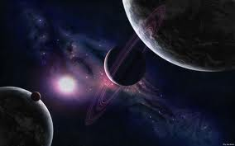
Earth and Space Systems
Grade 6-Space

Slide 3
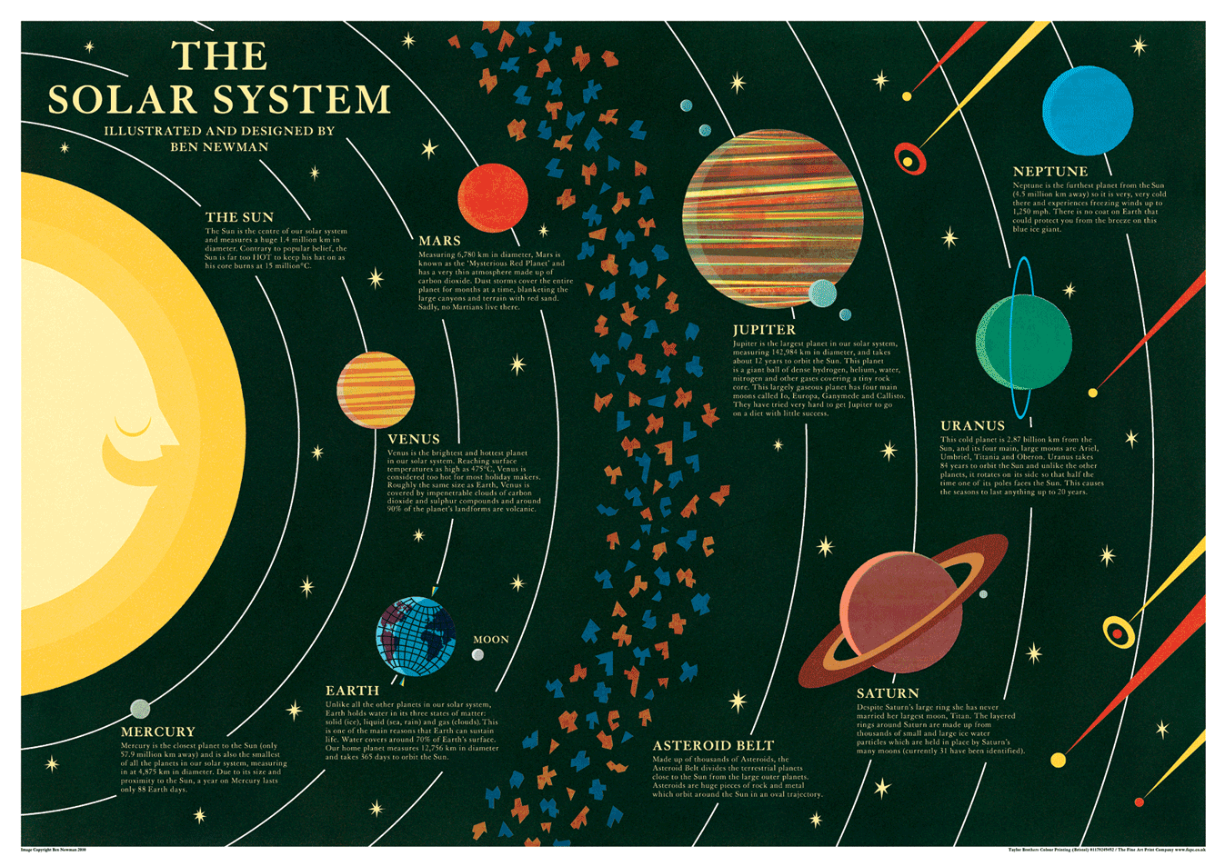
What’s Out There?
The Solar System
Which planet will be the hot new destination for discovery?

Slide 4
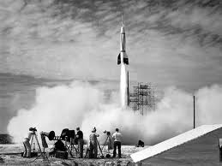
Why do we go into space?
Early space exploration was done with unmanned rockets.
This picture was taken in 1958.

Slide 5
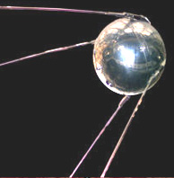
First Satellites
Sputnik 1957
What country did Sputnik come from?
Why was Sputnik so important?

Slide 6
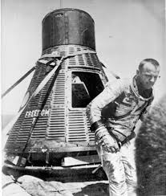
The first Astronauts
Who were the first astronauts?
Was space travel more dangerous in the beginning?

Slide 7
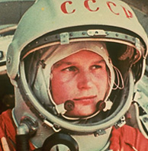
First Woman in Space
Valentina Tereshkova
Why was she important to space travel?
Can you name other women in space?

Slide 8
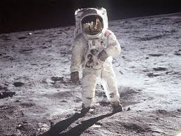
Landing on the Moon
Who were the first astronauts on the Moon?
Why did they go there?

Slide 9
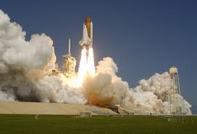
Space Shuttles
Can you name any space shuttles?
What are the steps in a shuttle launch and journey?

Slide 10
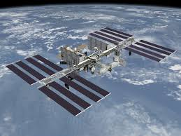
Space Station
What do you think a space station looks like inside?

Slide 11
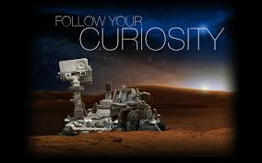
Exploring Mars
What is Curiosity?
Why is it important in space exploration?

